Slide 1

CPU SCHEDULING
Operating Systems
(CS-2006) SPRING 2022 FAST NUCES
anaum.hamid@nu.edu.pk

Slide 2
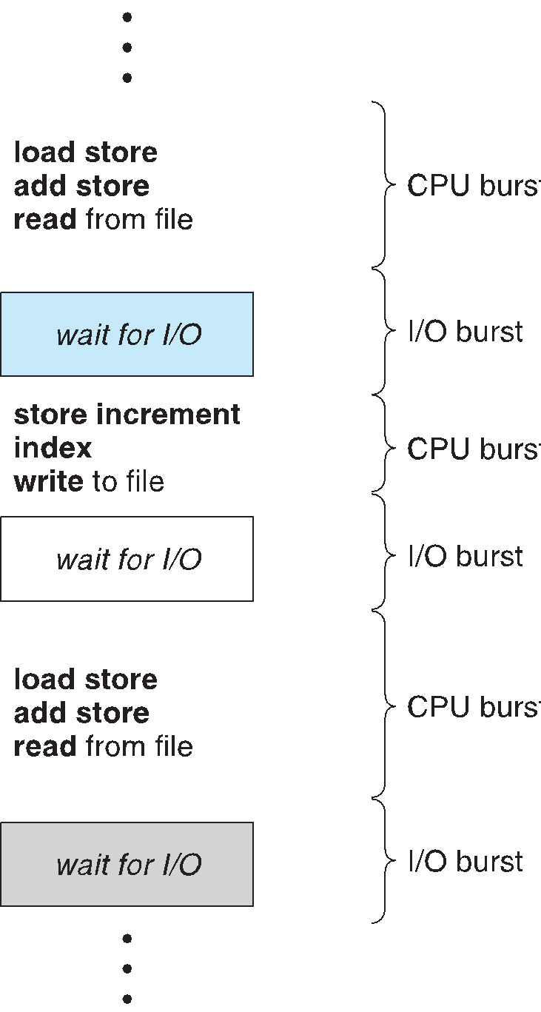
CPU–I/O BURST CYCLE
All processes alternate between two states in a continuing cycle; A CPU burst of performing calculations, and An I/O burst, waiting for data transfer in or out of the system.
Process execution consists of a cycle of CPU execution and I/O wait.
CPU burst followed by I/O burst.
CPU burst distribution is of main concern

Slide 3
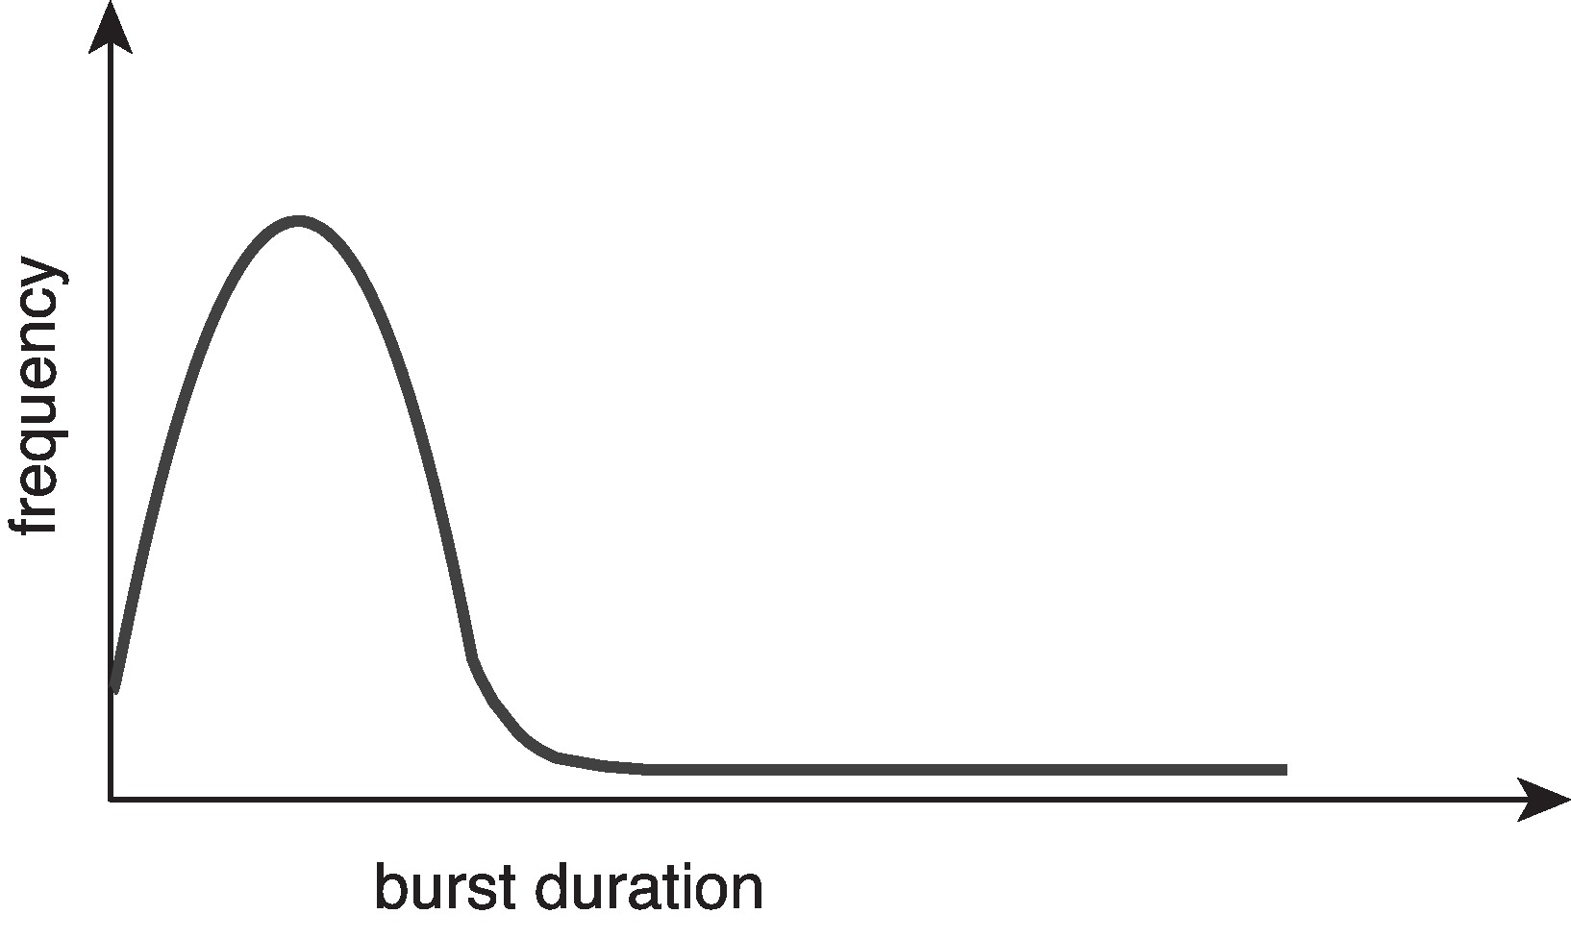
HISTOGRAM OF CPU-BURST TIMES
Large number of short bursts
Small number of longer bursts
Histogram

Slide 4
CPU SCHEDULER
Short-term scheduler selects from among the processes in ready queue, and allocates the CPU to one of them
Queue may be ordered in various ways
CPU scheduling decisions may take place when a process:
Switches from running to waiting state.
Switches from running to ready state.
Switches from waiting to ready.
Terminates.
Scheduling under 1 and 4 is Non-Preemptive - A new process must be selected.
All other scheduling is Preemptive - There is a choice - To either continue running the current process or select a different one.
Consider access to shared data
Consider preemption while in kernel mode
Consider interrupts occurring during crucial OS activities

Slide 5

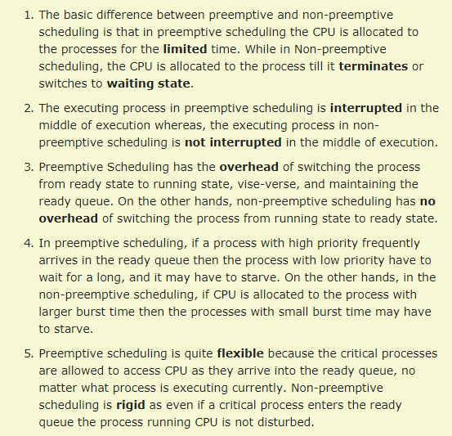
PRE-EMPTIVE VS NON- PREEMPTIVE

Slide 6
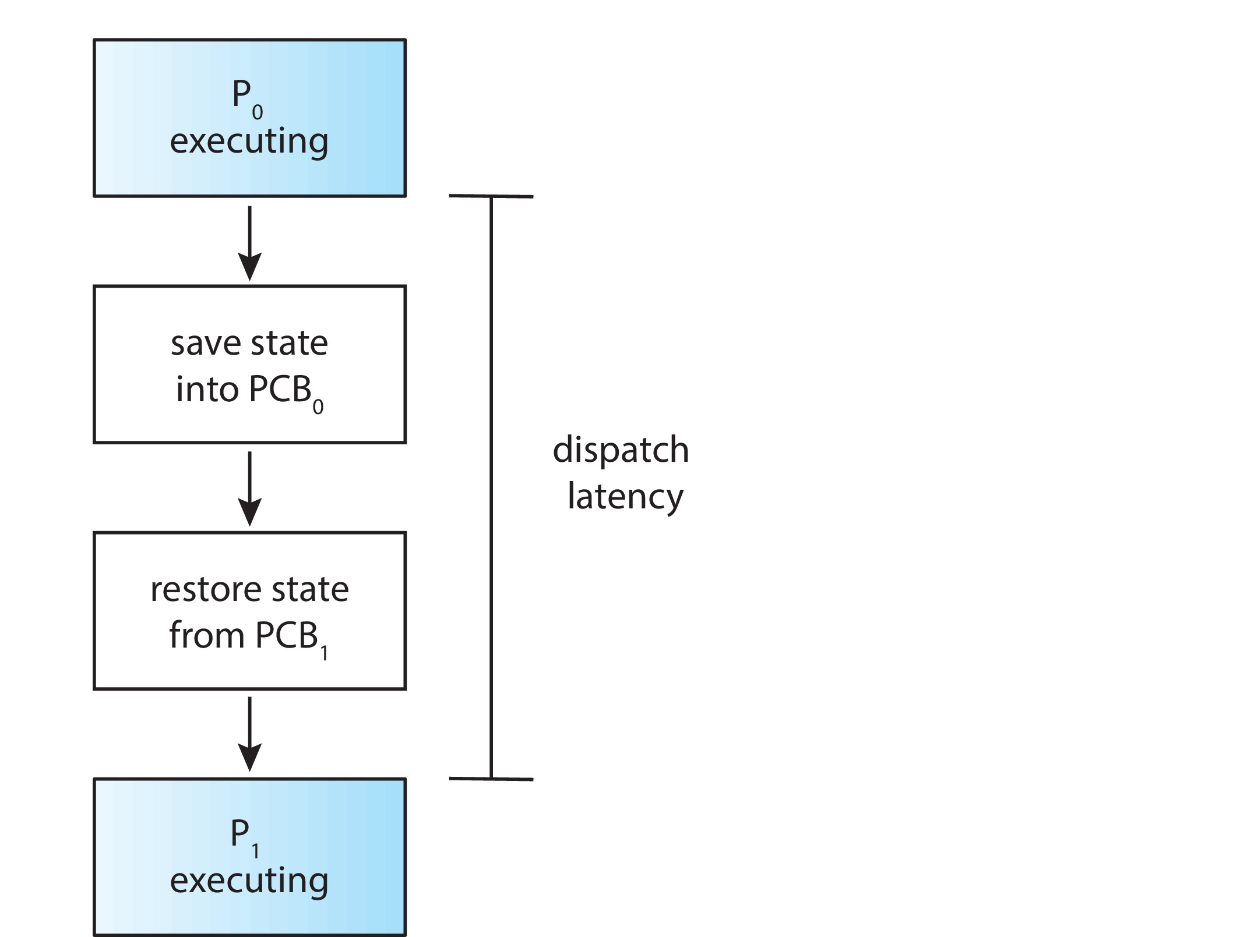
DISPATCHER
Dispatcher module gives control of the CPU to the process selected by the short-term scheduler; this involves:
switching context
switching to user mode
jumping to the proper location in the user program to restart that program
Dispatch latency – time it takes for the dispatcher to stop one process and start another running

Slide 7
SCHEDULING CRITERIA
CPU utilization – Ideally the CPU would be busy 100% of the time, to waste 0 CPU cycles. On a real system CPU usage should range from 40% ( lightly loaded ) to 90% ( heavily loaded. )
Throughput –Number of processes completed per unit time. May range from 10 / second to 1 / hour depending on the specific processes.
Turnaround time – Amount of time required for a particular process to complete, from submission time to completion. ( Wall clock time. )
Waiting time – Amount of time processes spend in the ready queue waiting their turn to get on the CPU
Response time – amount of time it takes from when a request was submitted until the first response is produced, not output (for time-sharing environment)

Slide 8
SCHEDULING ALGORITHM OPTIMIZATION CRITERIA
Max CPU utilization
Max throughput
Min turnaround time
Min waiting time
Min response time

Slide 9
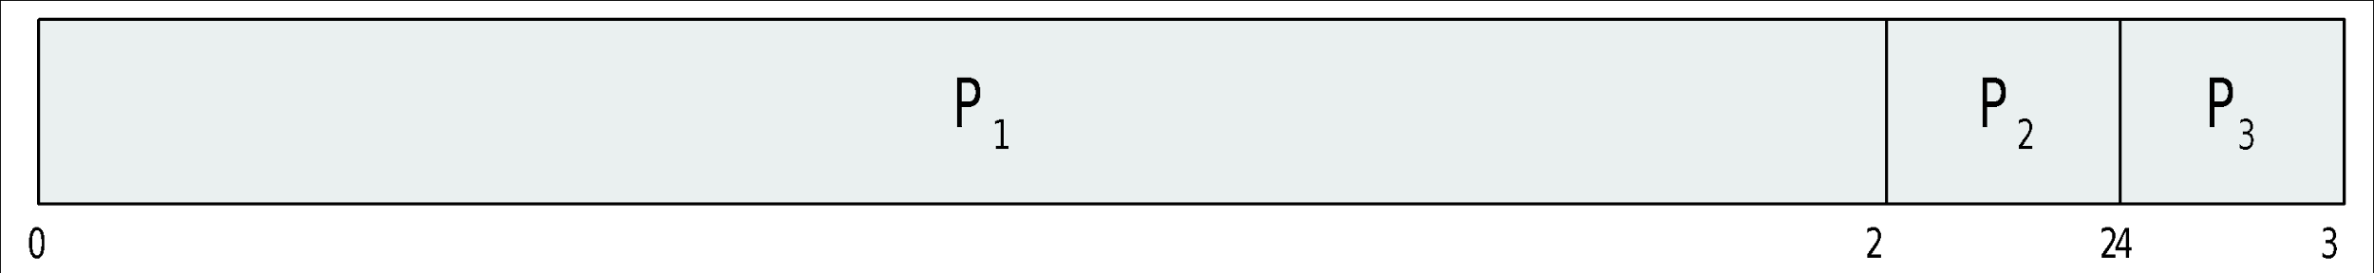
FIRST- COME, FIRST-SERVED (FCFS) SCHEDULING
Process Burst Time
P₁ 24
P₂ 3
P₃ 3
Suppose that the processes arrive in the order: P₁ , P₂ , P₃ The Gantt Chart for the schedule is:
Waiting time for P₁ = 0; P₂ = 24; P₃ = 27
Average waiting time: (0 + 24 + 27)/3 = 17

Slide 10
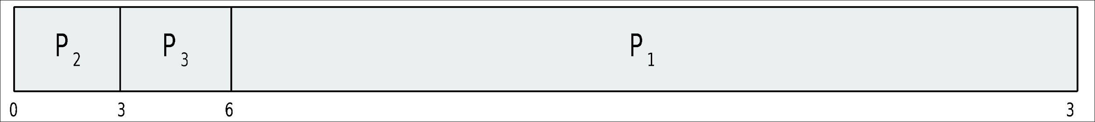
FCFS SCHEDULING (CONT.)
Suppose that the processes arrive in the order:
P₂ , P₃ , P₁
The Gantt chart for the schedule is:
Waiting time for P₁ = 6; P₂ = 0; P₃ = 3
Average waiting time: (6 + 0 + 3)/3 = 3
Much better than previous case
Convoy effect - short process behind long process. All other short processes are left behind a big long process to be done by CPU.
Consider one CPU-bound and many I/O-bound processes

Slide 11
SHORTEST-JOB-FIRST (SJF) SCHEDULING
Associate with each process the length of its next CPU burst
Use these lengths to schedule the process with the shortest time
SJF is optimal – gives minimum average waiting time for a given set of processes
The difficulty is knowing the length of the next CPU request
Could ask the user

Slide 12
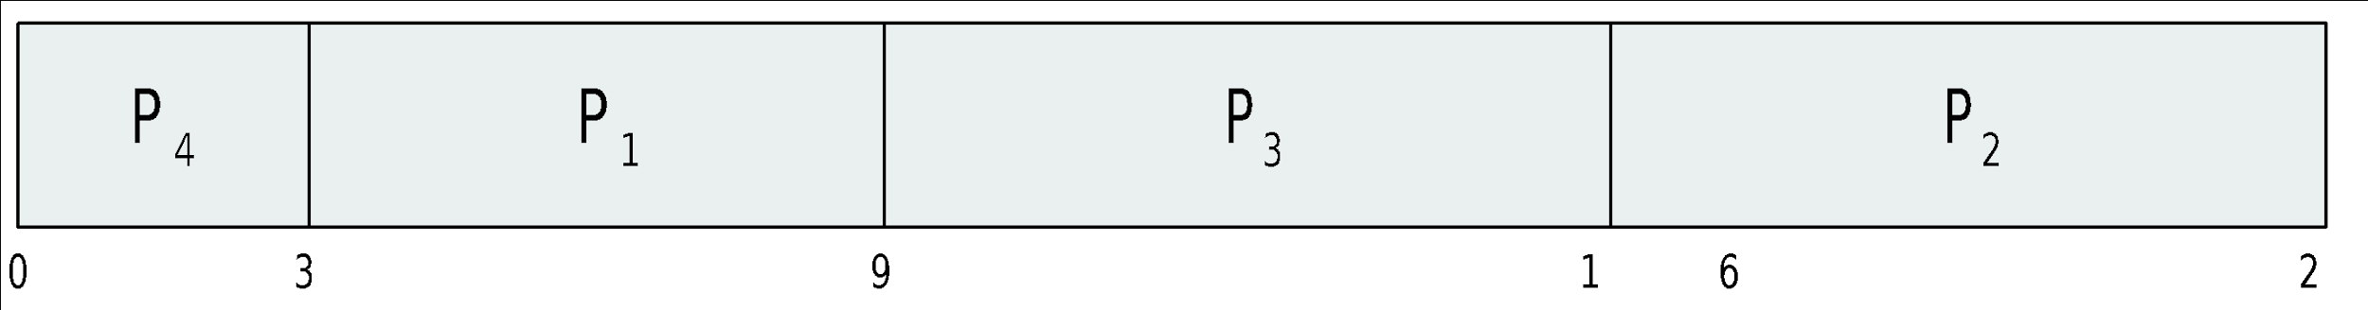
EXAMPLE OF SJF
ProcessArriva l Time Burst Time
P₁ 0.0 6
P₂ 2.0 8
P₃ 4.0 7
P₄ 5.0 3
SJF scheduling chart
Average waiting time = (3 + 16 + 9 + 0) / 4 = 7

Slide 13
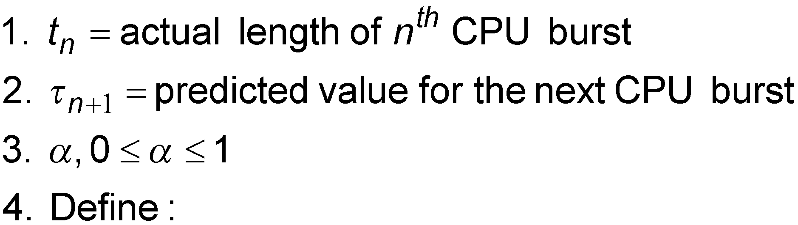
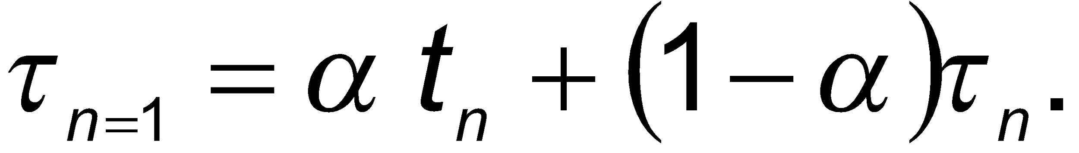
DETERMINING LENGTH OF NEXT CPU BURST
Can only estimate the length – should be similar to the previous one
Then pick process with shortest predicted next CPU burst
Can be done by using the length of previous CPU bursts, using exponential averaging
Commonly, α set to ½
Preemptive version called shortest-remaining-time-first

Slide 14
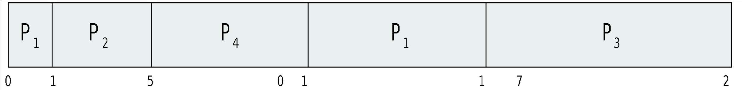
EXAMPLE OF SHORTEST-REMAINING-TIME-FIRST
Now we add the concepts of varying arrival times and preemption to the analysis
ProcessA arri Arrival TimeT Burst Time
P₁ 0 8
P₂ 1 4
P₃ 2 9
P₄ 3 5
Preemptive SJF Gantt Chart
Waiting Time = (Total waiting time - #of MS executing earlier – Arrival Time)
WT = (10-1-0)+(1-0-1)+(17-0-2)+(5-0-3) = 26/4 = 6.5
Average waiting time = 6.5 msec

Slide 15
PRIORITY SCHEDULING
A priority number (integer) is associated with each process
The CPU is allocated to the process with the highest priority (smallest integer ≡ highest priority)
Preemptive
Nonpreemptive
SJF is priority scheduling where priority is the inverse of predicted next CPU burst time
Problem ≡ Starvation – low priority processes may never execute
Solution ≡ Aging – as time progresses increase the priority of the process

Slide 16
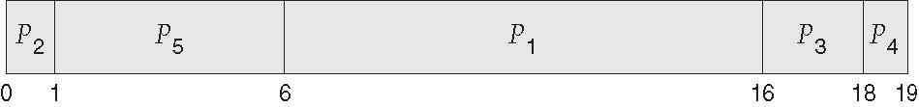
EXAMPLE OF NON-PREEMPTIVE PRIORITY SCHEDULING
ProcessA arri Burst TimeT Priority
P₁ 10 3
P₂ 1 1
P₃ 2 4
P₄ 1 5
P₅ 5 2
Priority scheduling Gantt Chart
WT = (6+0+16+18+1) = 41/5 = 8.2
Average waiting time = 8.2 msec

Slide 17
EXAMPLE OF PREEMPTIVE PRIORITY SCHEDULING (SEE CLASS LECTURE)

Slide 18
ROUND ROBIN (RR)
Specially designed for timesharing/ time slicing systems.
Each process gets a small unit of CPU time (time quantum q), usually 10-100 milliseconds. After this time has elapsed, the process is preempted and added to the end of the ready queue.
Timer interrupts every quantum to schedule next process.
Ready queue acts alike circular queue.
Performance
q large ⇒ FIFO
q small ⇒ q must be large with respect to context switch, otherwise overhead is too high

Slide 19
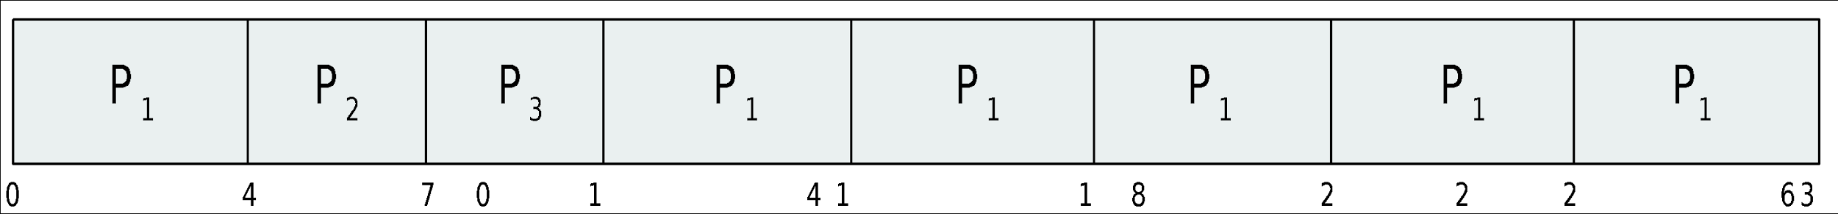
EXAMPLE OF RR WITH TIME QUANTUM = 4
Process Burst Time
P₁ 24
P₂ 3
P₃ 3
The Gantt chart is:
Typically, higher average turnaround than SJF, but better response
q should be large compared to context switch time
q usually 10ms to 100ms, context switch < 10 usec

Slide 20
EXAMPLE OF ROUND ROBIN SCHEDULING (SEE CLASS LECTURE)

Slide 21
MULTILEVEL QUEUE
Ready queue is partitioned into separate queues, eg:
foreground (interactive)
background (batch)
Process permanently in each queue
Each queue has its own scheduling algorithm:
foreground – RR
background – FCFS
Scheduling must be done between the queues:
Fixed priority scheduling; (i.e., serve all from foreground then from background). Possibility of starvation.
Time slice – each queue gets a certain amount of CPU time which it can schedule amongst its processes; i.e., 80% to foreground in RR
20% to background in FCFS

Slide 22
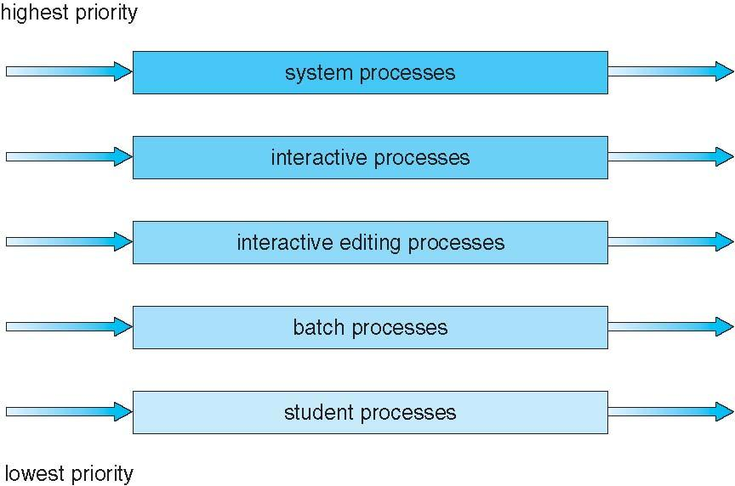
MULTILEVEL QUEUE SCHEDULING

Slide 23
MULTILEVEL FEEDBACK QUEUE
A process can move between the various queues; aging can be implemented this way
Multilevel-feedback-queue scheduler defined by the following parameters:
Number of queues
Scheduling algorithms for each queue
Method used to determine when to upgrade a process
Method used to determine when to demote a process.
Method used to determine which queue a process will enter when that process needs service

Slide 24
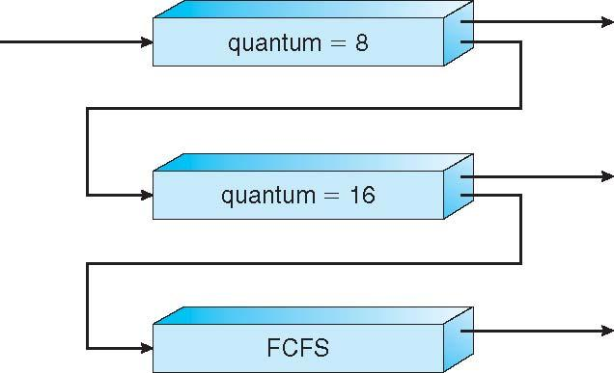
EXAMPLE OF MULTILEVEL FEEDBACK QUEUE
Three queues:
Q₀ – RR with time quantum 8 milliseconds
Q₁ – RR time quantum 16 milliseconds
Q₂ – FCFS
Scheduling
A new job enters queue Q₀ which is served FCFS
When it gains CPU, job receives 8 milliseconds
If it does not finish in 8 milliseconds, job is moved to queue Q₁
At Q₁ job is again served FCFS and receives 16 additional milliseconds
If it still does not complete, it is preempted and moved to queue Q₂

Slide 25
MULTIPLE-PROCESSOR SCHEDULING
CPU scheduling more complex when multiple CPUs are available
Homogeneous processors within a multiprocessor
Asymmetric multiprocessing – only one processor accesses the system data structures, alleviating the need for data sharing
Symmetric multiprocessing (SMP) – each processor is self-scheduling, all processes in common ready queue, or each has its own private queue of ready processes
Currently, most common

Slide 26
PROCESSOR AFFINITY
Processor affinity – process has affinity for processor on which it is currently running
soft affinity
hard affinity
Variations including processor sets
Soft affinity is a mechanism that keeping process on the same CPU if possible, otherwise, process is migrated to another processor.
Hard affinity is a mechanism that enables processes can run only on a fixed set of one or more processor(s).

Slide 27
MULTIPLE-PROCESSOR SCHEDULING – LOAD BALANCING
If SMP, need to keep all CPUs loaded for efficiency
Load balancing attempts to keep workload evenly distributed
Push migration – periodic task checks load on each processor, and if found pushes task from overloaded CPU to other CPUs
Pull migration – idle processors pulls waiting task from busy processor

Slide 28
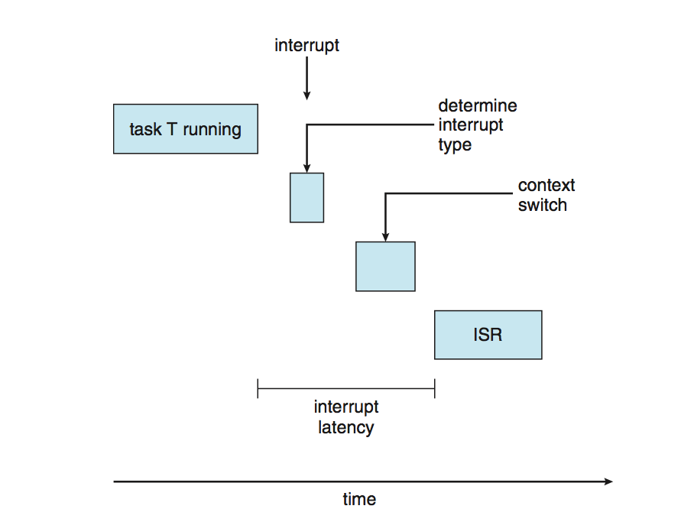
REAL-TIME CPU SCHEDULING
Can present obvious challenges
Soft real-time systems – no guarantee as to when critical real-time process will be scheduled
Hard real-time systems – task must be serviced by its deadline
Two types of latencies affect performance
Interrupt latency – time from arrival of interrupt to start of routine that services interrupt.
Dispatch latency – time for schedule to take current process off CPU and switch to another

Slide 29

THANK YOU! CPU SCHEDULING COMPLETED

